Slide 1

Online Loan Application Decision Making
By
Lyal Mahmoud Abd Ali
Teeba Saeed Mohammed
Supervisor
Lecturer
Hasan F. Hasan

Slide 2
Introduction
Online loan application decision making system mainly aims to assist customer, brokers, banker and financial authorities to assess any loan application.
It has been modeled to play an essential role among these parties in order to check on client’s application during entire process.
It gathers four different type of data in which they are, personnel, employment ,addresses and banking details to perform financial check in order to state customer situation.
Linking all parties serially.
Less time consumption and secure mode via creating each client account based on protecting acts regulations.
Highly dedicated DB, fast performance
Less cost requirement.
Applying anywhere, anytime with no restrictions.
Open to public.

Slide 3

Problem Statement
Slow processing to acquire a decision.
2. Client fraud detection not always spotted.
3. Ignoring alerts regarding such client history.
4. Client’s payback with risks.

Slide 4
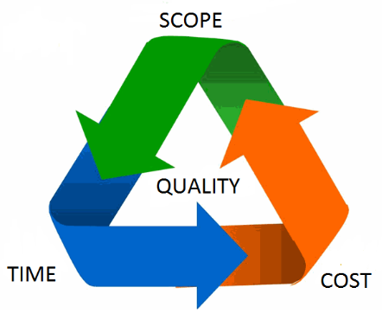
Project Scope
Customer Information management through
creating accounts record .
Linked parties will be benefited from updating
each client data.
Using addresses database as an addition factor
in order to support taken decision.
Anytime anywhere concepts applied.
Reduce cost and human work forces required.
Spreading other financial services instantly.
Other offers might attract the clients.

Slide 5

Project Features
1. The project is characterized by giving each customer private account.
Storing and updating customer information into Financial Authorities
DB.
3. Highly available to all customer types.
4. Time, cost and quality are high.
5. Client fraud history spotted.
Stop ignoring alerts regarding such client.
Unified DB platforms are used.

Slide 6

Aims & Objectives
Efficient Dorms website.
Less effort and time spent.
Maintain an integrated database containing all student data.
Make registration process quick and easy.
Time saving.
Cost reduction.
Highly availability.
Less human interaction.
Ensuring clients payback.
Allow only for student register.

Slide 7
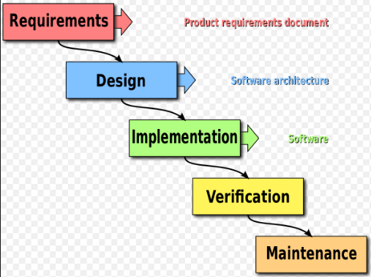
The Method of Work
The website will be designed based on careful designed
Requirements.
Only students are allowed to register after some verification steps.
Using professional and powerful tools.
Enhanced system architecture has been employed in the design.
Latest Programming and DB tools have been used.
Careful consideration to all details.

Slide 8
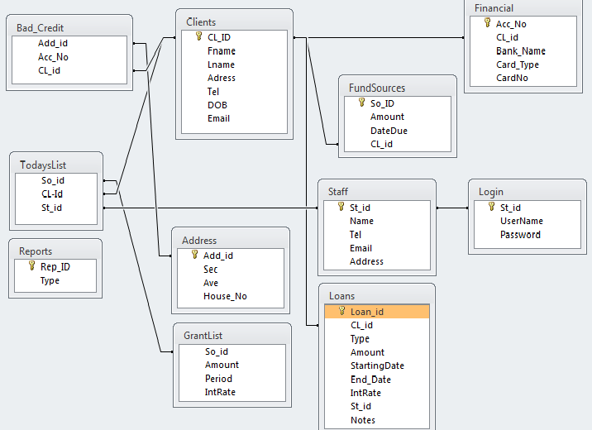
System ERD

Slide 9
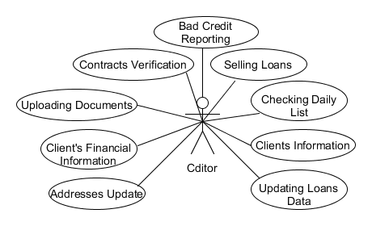
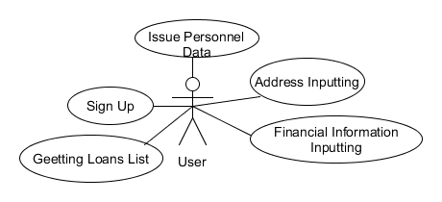
Functional Requirements

Slide 10
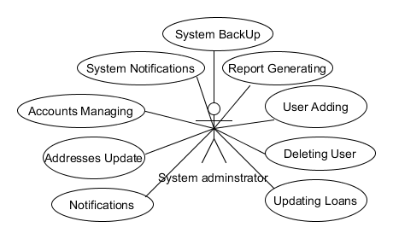
Non Functional Requirements

Slide 11
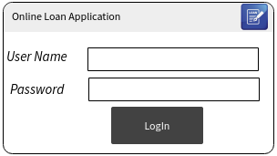
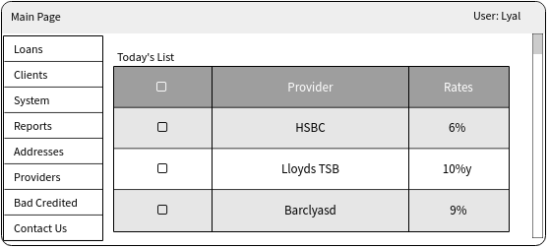
GUI Sequence Samples

Slide 12
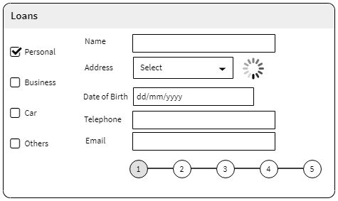
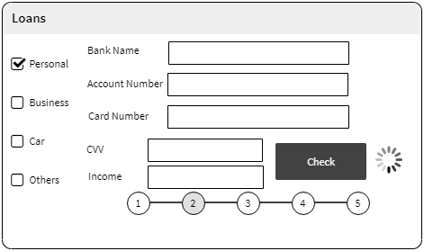

Slide 13
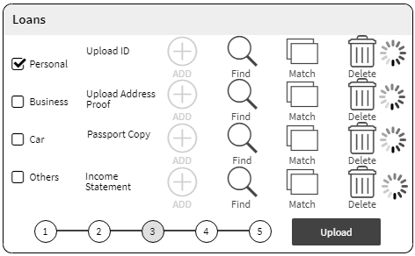
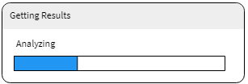
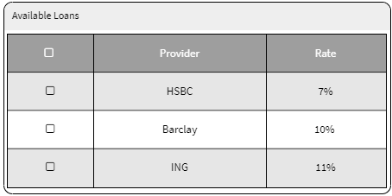

Slide 14

Project Outcomes
Easy and fast registration process
Easy and fast update students information .
Help management unit Access to student information fast .
Reduce burden at management unit staff
5. Reduce burden at Parents of students.
6. Cost reduction for students.
7. Depending on students dorm card for all year.
8. Use the web site to view the news of the internal dorms, the conditions for applying for housing, and registration dates

Slide 15
Thank You
Q & A

